Slide 1
Software Maintenance and Computer Aided Software Engineering (CASE)

Slide 2
Introduction
Software maintenance:
  any modifications to a software product after it has been delivered to the customer.
Software maintenance is an important activity for many organizations.

Slide 3
Introduction
Maintenance is inevitable for almost any kind of product.
Most products need maintenance:
  due to wear and tear caused by use.
Software products do not need maintenance on this count.

Slide 4
Introduction
Many people think
  only bad software products need maintenance.
The opposite is true:
  bad products are thrown away,
  good products are maintained and used for a long time.

Slide 5
Introduction
Software products need maintenance for three reasons:
  corrective
  adaptive
  perfective

Slide 6
Corrective
Corrective maintenance of a software product:
  to correct bugs observed while the system is in use.
  to enhance performance of the product.

Slide 7
Adaptive
A software product needs maintenance (porting) when customers:
  need the product to run on new platforms,
    or, on new operating systems,
  need the product to interface with new hardware or software.

Slide 8
Perfective
Perfective maintenance:
  to support new features required by users.
  to change some functionality
  of the system due to customer demands.

Slide 9
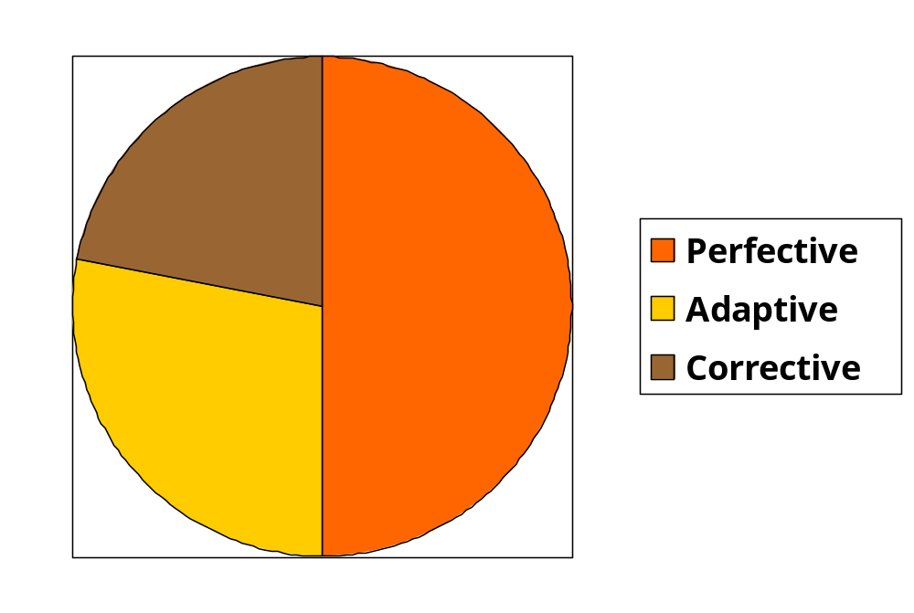
Maintenance Effort Distribution

Slide 10
Causes for maintenance
During development:
  Software not anticipated to last very long (e.g., Y2K problem).
Rate of hardware obsolescence:
  immortality of software products
  maintenance necessary for software performing low-level functions.

Slide 11
Causes for maintenance
Users want existing software to run on new platforms:
  to run in new environments,
  and/or with enhanced features.

Slide 12
Causes for maintenance
Whenever other software it works with change:
  maintenance is needed to cope up with the newer interface.
  For instance, a software product may need maintenance when the operating system changes.

Slide 13
Software evolution
Every software product continues to evolve after its development:
  through maintenance efforts.
Larger software products stay in operation for longer time:
  because of high replacement cost.

Slide 14

Laws of Maintenance
There will always be a lot
of old software needing
maintenance.
Good products are
maintained, bad products
are thrown away.

Slide 15
Laws of Maintenance
Lehman’s first Law:
“Software products must change continuously, or become progressively less useful.”

Slide 16
Laws of Maintenance
Lehman’s Second Law
“When software is maintained, its structure degrades,
  unless active efforts are made to avoid this phenomenon.”

Slide 17
Laws of Maintenance
Lehman’s Third Law:
“Over a program’s life time,
  its rate of development is approximately constant.”

Slide 18
Other Laws of Maintenance
All large programs will undergo significant changes during operation phase of their life cycle,
  regardless of apriori intentions.

Slide 19
Legacy code--- Major maintenance problems
Unstructured code (bad programs)
Maintenance programmers have:
  insufficient knowledge of the system or the application domain.
  Software maintenance has a bad image.
Documentation absent, out of date, or insufficient.

Slide 20
Insufficient knowledge
Maintenance team is usually different from development team.
  even after reading all documents
    it is very difficult to understand why a thing was done in a certain way.
  Also there is a limit to the rate at which a person can study documents
    and extract relevant information

Slide 21
Bad image of maintenance?
Maintainers are skilled not only in writing code:
  proficient in understanding others’ code
  detecting problems, modifying the design, code, and documentation
  working with end-users

Slide 22
Maintenance Nightmares
Use of gotos
Lengthy procedures
Poor and inconsistent naming
Poor module structure
Weak cohesion and high coupling
Deeply nested conditional statements
Functions having side effects

Slide 23
How to do better maintenance?
Program understanding
Reverse engineering
Design recovery
Reengineering
Maintenance process models

Slide 24
Maintenance activities
Two types of activities:
  Productive activities:
    modification of analysis, design, coding, etc.
  Non-productive activities:
    understanding system design, code, etc.

Slide 25
Software Reverse Engineering
By analyzing a program code, recover from it:
  the design and the requirements specification.

Slide 26
Software Reverse Engineering
Reverse engineering is an important maintenance technique:
  several existing software products are unstructured,
  lack proper documentation,
  were not developed using software engineering principles.

Slide 27
Software Reverse Engineering
First carry out cosmetic changes to the code to improve:
  readability,
  structure,
  understandability.

Slide 28
Cosmetic changes
Reformat Program
Assign Meaningful
Names
Simplify Conditions
Simplify Processing
Replace GOTOs

Slide 29
Cosmetic Changes
Reformat the program:
  use any pretty printer program
  layout the program neatly.
Give more meaningful names to:
  Variables, data structures, and functions.

Slide 30
Cosmetic Changes
Replace complex and nested conditional expressions:
  simpler conditional statements
  whenever appropriate use case statements.

Slide 31
Software Reverse Engineering
In order to extract the design:
  fully understand the code.
Automatic tools can be used to help derive:
  data flow and control flow diagrams from the code.

Slide 32
Software Reverse Engineering
Extract structure chart:
  module invocation sequence and data interchange among modules.
Extract requirements specification:
  after thoroughly understanding the code.
  design has been extracted.

Slide 33
Software Maintenance Process Models
Maintenance activities are not unique:
  depend on the extent of modifications required,
  also, depend on condition of the product:
    how structured it is,
    how well documented it is, etc.

Slide 34
Software Maintenance Process Model - 1
When the required changes are small and simple:
  the code can be directly modified
  changes reflected in all relevant documents.
  more elaborate activities are required when required changes are not trivial.

Slide 35
Software Maintenance Process Model - 1
Gather Change Requirements
Analyze Change Requirements
Devise Code Change Strategies
Apply Code Change Strategies
Update Documents
Integrate and Test

Slide 36
Software Maintenance Process Model 1
Start by gathering change requirements.
Analyze change requirements
  formulate strategies for code change.

Slide 37
Software Maintenance Process Model 1
Formulating strategies for code change:
  presence of few members of the original development team
    helps in reducing cycle time,
    especially for unstructured and inadequately documented code.

Slide 38
Software Maintenance Process Model 1
Availability of a working old system at the maintenance site:
  greatly helps the maintenance team
  provides a good insight into the working of the old system
  can compare the working of the modified system with the old system.

Slide 39
Software Maintenance Process Model 1
Debugging the system under maintenance becomes easier:
  program traces of both the systems can be compared to localize bugs.

Slide 40
Software Maintenance Process Model -2
For complex maintenance projects, software reengineering needed:
  a reverse engineering cycle followed by a forward engineering cycle.
  with as much reuse as possible from existing code and other documents.

Slide 41
Maintenance Process Model 2
Preferable when:
  amount of rework is significant
  software has poor structure.
Can be represented by a reverse engineering cycle:
  followed by a forward engineering cycle.

Slide 42
Software reengineering
Many aging software products belong to this category.
During the reverse engineering,
  the old code is analyzed (abstracted) to extract the module specifications.

Slide 43
Software reengineering
The module specifications are analyzed
  to produce the design.
The design is analyzed (abstracted)
  to produce the original requirements specification.
The change requests are then applied to the requirements specification:
  arrive at the new requirements specification.

Slide 44
Software reengineering
Forward engineering is carried out to produce the new code.
During design, module specification, and coding:
  substantial reuse is made from the reverse engineered products.

Slide 45
Process model for Software reengineering
Change Requirements
Requirements Specification
New Requirements Specification
Design
Design
Code
Code

Slide 46
Software reengineering
Advantages of reengineering:
  produces better design than the original product,
  produces required documents,
  often results in higher efficiency.

Slide 47
Software reengineering
Efficiency improvements are brought about by better design.
  However, this approach is more costly than the first approach.
An empirical study indicates:
  process 1 is preferable when amount of rework is no more than 15%.

Slide 48
Software reengineering
Reengineering is preferable when:
  amount of rework is high,
  product exhibits high failure rate.
  product difficult to understand.

Slide 49
Computer Aided Software Engineering (CASE)
CASE tools help in
software development
and maintenance.
CASE is a much talked about topic in software industries.

Slide 50
CASE and Its Scope
CASE tool is a generic term:
  denotes any form of automated support for software engineering.
In a more restrictive sense:
  a CASE tool automates some software development activity.

Slide 51
CASE and Its Scope
Some CASE tools assist in phase-related tasks:
  specification, structured analysis, design, coding, testing, etc.
Other tools help non-phase activities:
  project management and configuration management.

Slide 52
Objectives of CASE
To increase productivity
To help produce better quality software at lower cost.

Slide 53
CASE Environment
Although individual CASE tools are useful:
  true power of a tool set can be realized only when:
    all CASE tools are integrated together.

Slide 54
CASE Environment
Tools covering different stages of life cycle share information (data):
  they should integrate through some central repository (store)
  consistent view of development information.

Slide 55
CASE Environment
The central repository is the data dictionary:
  contains definition of all composite and elementary data items.
  through this repository all CASE tools share information.

Slide 56
Programming Environment
A CASE environment helps:
  automate step-by-step methodologies.
In contrast to CASE environment:
  a programming environment denotes tools supporting coding phase alone.

Slide 57
Schematic representation of architecture of CASE environment
Consistency-
checker
Testing
Central
Repository
Project
Management
Structured
Design
Structured
Analysis
Coding
Support
Document
Generation
Configuration
Management

Slide 58
Benefits of CASE
A key benefit of using CASE environment:
  cost saving through all developmental phases.
Studies carried out to measure the impact of CASE usage:
  cost saving between 30% to 40%.

Slide 59
Benefits of CASE
Use of CASE tools leads to improvements in quality:
  becomes easy to iterate through different software development phases.
  chances of human error is reduced.
  CASE tools help produce higher quality and consistent documents.

Slide 60
Benefits of CASE
Data relating to a software product are maintained in a central repository:
  redundancy in the stored data is reduced.
  chances of inconsistent documentation is reduced.

Slide 61
Benefits of CASE
CASE tools take drudgery out from software engineers’ work:
  engineers need not manually check balancing of the DFDs
  easily draw diagrams and produce documentation, etc.

Slide 62
Benefits of CASE
CASE tools lead to cost saving in software maintenance effort:
  traceability and consistency checks,
  systematic information capture during various development phases.

Slide 63
Benefits of CASE
Introduction of a CASE environment:
  impacts the style of working of engineers.
  makes them oriented towards structured and orderly approach.

Slide 64
Prototyping Support
Prototyping CASE tool:
  often used in graphical user interface (GUI) development,
  supports creating a GUI using a graphics editor.

Slide 65
Prototyping Support
The user should be allowed to define:
  data entry forms, menus and controls.
It should integrate with the data dictionary of a CASE environment.

Slide 66
Structured Analysis and Design
A CASE tool should:
  support some standard structured analysis and design technique.
  support easy creation of analysis and design diagrams.
  should provide easy navigation through different levels of design and analysis diagrams.

Slide 67
Structured Analysis and Design
The tool must support completeness and consistency checking.
The tool should disallow inconsistent operations:
  but, it is difficult to implement such a feature.

Slide 68
Code Generation
As far as code generation is concerned:
  expectations from a CASE tool is low.
The CASE tool should support:
  generation of module skeletons in one or more popular languages.
  Another reasonable requirement is traceability from source code to design.

Slide 69
Code Generation
It should automatically generate header information:
  copyright messages,
  brief description of the module,
  author name and date of creation, etc.

Slide 70
Code Generation
The tool should generate data records or structures automatically:
  using data dictionary definitions.
  It should generate database tables for relational database management systems.

Slide 71
Code Generation
The tool should generate code for user interface from the prototype:
  for X window and MS window based applications.

Slide 72
Testing Support
Static and dynamic program analysis of programs.
It should generate test reports in ASCII format:
  which can be directly imported into the test plan document.

Slide 73
Desirable Features
The tool should work satisfactorily
  when many users work simultaneously.
The tool should support windowing interface:
  Enable the users to see more than one diagram at a time.
  Facilitate navigation and switching from one part to the other.

Slide 74
Documentation Support
The deliverable documents:
  should be able to incorporate text and diagrams from the central repository.
  help in producing up-to-date documentation.

Slide 75
Desirable Features
The CASE tool should integrate
  with commercially available desk-top publishing packages.
It should be possible to export text, graphics, tables, data dictionary reports:
  to DTP packages in standard formats such as PostScript.

Slide 76
Project Management
It should support collecting, storing, and analyzing information on the software project's progress:
  such as the estimated task duration,
  scheduled and actual task start, completion date, dates and results of the reviews, etc.

Slide 77
External Interface
The tool should allow exchange of information for reusability of design.
  The information exported by the tool should preferably be in ASCII format.
The data dictionary should provide
  a programming interface to access information.

Slide 78
Reverse Engineering Support
The tool should support:
  generating structure chart, DFD, and data dictionary from source code.
  should populate the data dictionary from source code.

Slide 79
Data Dictionary Interface
Data dictionary interface should provide
  viewing and updating the data definitions.
  print facility to obtain hard copy of the viewed screens.
  analysis reports like cross-referencing, impact analysis, etc.
  it should support a query language.

Slide 80
Tutorial and Help
Successful use of CASE tools:
  depends on the users’ capability to effectively use all supported features.
For the first time users:
  a computer animated tutorial is very important.

Slide 81
Tutorial and Help
The tutorial should not be limited to teaching the user interface part only:
  The tutorial should logically classify and cover all techniques and facilities.
  The tutorial should be supported by proper documentation and animation.

Slide 82
Towards Next Generation CASE Tool
An important feature of next generation CASE tools:
  be able to support any methodology.
Necessity of a CASE administrator for every organization:
  who would tailor the CASE environment to a particular methodology.

Slide 83
Intelligent Diagramming Support
Future CASE tools would
  aesthetically and automatically lay out the diagrams.

Slide 84
Towards Next Generation CASE Tool
The user should be allowed to:
  integrate many different tools into one environment.
  It is highly unlikely that any one vendor will be able to deliver a total solution.

Slide 85
Towards Next Generation CASE Tool
A preferred tool would support tune up:
  user would act as a system integrator.
  This is possible only if some data dictionary standard emerges.

Slide 86
Customization Support
The user should be allowed to define new types of objects and connections.
This facility may be used to build some special methodologies.
Ideally it should be possible to specify the rules of a methodology to a rule engine:
  for carrying out the necessary consistency checks.

Slide 87
Summary
We discussed some fundamental concepts in software maintenance.
Maintenance is the mostly expensive phase in software life cycle:
  during development emphasize on maintainability to reduce the maintenance costs.

Slide 88
Summary
We discussed software reverse engineering:
  extract design from code.
Reengineering is a reverse engineering cycle:
  followed by a forward engineering cycle

Slide 89
Summary
Maintenance process models:
  Process model for small changes
  Process model for reengineering
We also discussed:
  applicability of process models to maintenance projects.

Slide 90
Summary
We discussed important features of present day CASE tools:
  and the emerging trends.
Use of CASE tools is indispensable for large software projects:
  where a team of software engineers work together.

Slide 91
Summary
The trend is now towards:
  distributed workstation-based CASE tools.
We discussed some desirable features of CASE tools.

